Slide 1
CPSC-6576 DATABASE DESIGN ADMIN SQL PROJECT STUDENT ACADEMIC DETAILS
SANJAY BOGA
1241032

Slide 2

Introduction
Student academic details is essential for the smooth operation of any university with a large student population. It is a useful database system for university departments because it allows them to store and view information about any student who is currently enrolled in which course. This is built with SQL server, which aids in the management of a university's student list. It also saves individual students' course-by-course grades, among other things.

Slide 3
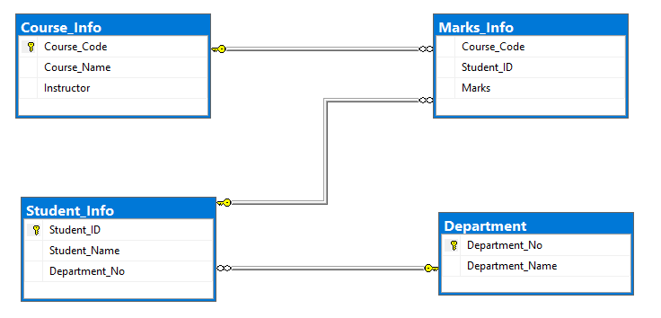
Database Diagram
In the above ERD, We have 4 Entities i.e. Course, Student, Marks and Department. The course has 3 attributes which are Course_Code, Course_Name and Instructor. A student also has 3 attributes those are Student_ID, Student Name and Department_No. Marks Entity consist of 3 attributes that are Course_Code, Student_ID and Marks. Finally, Department composes of only 2 attributes i.e. Department_No and Department_Name. The diagram above depicts three total relationships: one - to - many between Course Info and Marks Info, Department and Student Info, and Student Info with Marks Info.

Slide 4
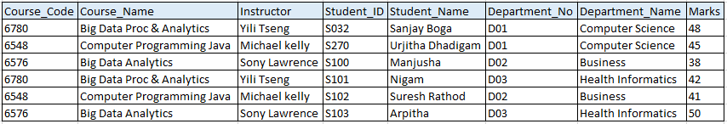
Normalisation
It, also known as database normalization, is the process of organizing data into database tables. Normalization practices must be followed when creating a good database design. A database system that lacks normalization may even be slow, inefficient, and fail to produce the expected results. Normalization reduces data redundancy and reliance on inconsistent data
To reduce duplication or redundancy of data in CPSC_6576_Student_Academic_Details, we must perform normalisation on the below data.

Slide 5
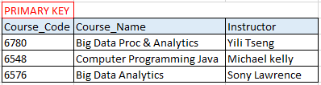
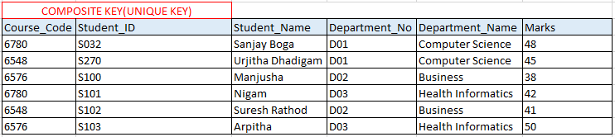
First Normal Form
If a database table contains no repeating fields/columns, it is said to be in 1NF.

Slide 6
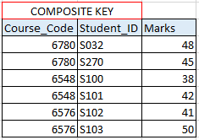
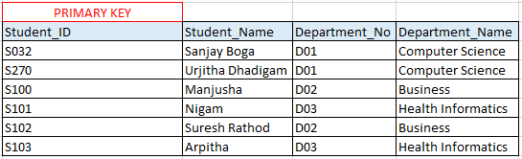
Second Normal Form
If a database table is in 1NF and only contains
fields/columns that are functionally dependent
on the primary key, it is said to be in 2NF.

Slide 7
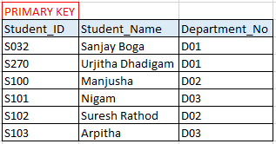
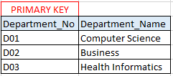
Third Normal Form
A database table is said to be in 3NF if it is in 2NF and all non-key fields are dependent on the primary key or A table is also said to be in 3NF if it is in 2NF and none of the table's fields is transitively functionally dependent on the primary key.

Slide 8
Constraints
SQL constraints are used to define the regulations that guide the data in a table. Constraints are used to restrict the types of data that can be entered into a table.
Table 1: Key Constraints, Entity Key Constraints, Check Constraints (Course_Name)
Table 2: Key Constraints, Referential Integrity Constraints, Check Constraints(Marks)
Table 3: Key Constraints, Entity Key Constraints, Referential Integrity Constraints, Check Constraints(Student_Name)
Table 4: Key Key Constraints, Entity Key Constraints
Course_Info
Makrs_Info
Department_Info
Student_Info

Slide 9
Views
A view is a virtual table in SQL that is based on the result set of a SQL statement. Views are used to focus on the concrete columns for the purposes for which they were designed. Views may also be used for security purposes. They filter out columns in the underlying tables that you don't want certain users to see.
Student_ID | Student_Name | Department_No | Department_Name
S032 | Sanjay Boga | D01 | Computer Science
S270 | Urjitha Dhadigam | D01 | Computer Science
View1: D01_Department
Student_ID | Student_Name | Department_No | Department_Name
S100 | Manjusha | D02 | Business
S102 | Suresh Rathod | D02 | Business
S998 | D Mahendran | D02 | Business
Student ID | Student_Name | Course Code | Course_Name | Mark | Per% | Grade
S032 | Sanjay Boga | 6780 | Big Data Analytics | 48 | 96 | A
S270 | Urjitha Dhadigam | 6780 | Big Data Analytics | 45 | 90 | B+
S100 | Manjusha | 6548 | Computer Programming Java | 38 | 76 | B-
S101 | Nigam | 6548 | Computer Programming Java | 42 | 84 | B-
S102 | Suresh Rathod | 6576 | Database Design Admin SQL | 41 | 82 | B-
S103 | Arpitha | 6576 | Database Design Admin SQL | 50 | 100 | A
S998 | D Mahendran | 6576 | Database Design Admin SQL | 43 | 86 | B+
View2: D02_Department
Student_ID | Student_Name | Department_No | Department_Name
S101 | Nigam | D03 | Health Informatics
S103 | Arpitha | D03 | Health Informatics
View3: D03_Department
View4: Student_CourseWise_Grading

Slide 10
Triggers
A trigger is a type of stored procedure that executes automatically when an event occurs in a database table
CREATE TRIGGER Trigger_Course_Info ON [dbo].[Course_Info] AFTER INSERT, DELETE AS BEGIN SET NOCOUNT ON; INSERT INTO [dbo].[Course_AuditsLogs]( Course_Code, Course_Name, Instructor, Updated_ON, Operation ) SELECT i.Course_Code, Course_Name, Instructor, GETDATE(), 'INS' FROM inserted i UNION ALL SELECT d.Course_Code, Course_Name, Instructor, GETDATE(), 'DEL' FROM deleted d; END
Insert into Course_Info values (8810,'Formal Languages and Automata','X Tang');
select * from [dbo].[Course_AuditsLogs]

Slide 11
Functions
SQL Server functions are database objects that contain a set of SQL statements to perform a specific task.
CREATE FUNCTION [dbo].[Get_StudentDetailsWithPercentage_Function] () RETURNS TABLE AS RETURN SELECT s.Student_ID,s.Student_Name,c.Course_Name,m.Marks, [dbo].[CalPercentage_Function](m.Marks,50) as Percentage FROM Student_Info s JOIN Department d ON s.Department_No = d.Department_No JOIN Marks_Info m ON m.Student_ID=s.Student_ID JOIN Course_Info c ON c.Course_Code = m.Course_Code
select * from [dbo].[Get_StudentDetailsWithPercentage_Function]()
Student_ID | Student_Name | Course_Name | Marks | Percentage
S032 | Sanjay Boga | Big Data Analytics | 48 | 96
S270 | Urjitha Dhadigam | Big Data Analytics | 45 | 90
S100 | Manjusha | Computer Programming Java | 38 | 76
S101 | Nigam | Computer Programming Java | 42 | 84
S102 | Suresh Rathod | Database Design Admin SQL | 41 | 82
S103 | Arpitha | Database Design Admin SQL | 50 | 100
S998 | D Mahendran | Database Design Admin SQL | 43 | 86

Slide 12

Stored Procedure
A SQL stored procedure (SP) is a collection of SQL statements and SQL command logic that is compiled and stored in a database. We can create SQL queries to be stored and executed on the server using stored procedures in SQL. Caching and reusing stored procedures is also possible. The primary goal of stored procedures is to hide direct SQL queries from the code and improve the performance of database operations like select, update, and delete data.
CREATE PROCEDURE SP_FunctionCall_Search_StudentDetails @Student_ID nvarchar(10) NULL AS BEGIN SET NOCOUNT ON; SELECT * from [dbo].[Search_StudentDetailsFunction] (@Student_ID); END GO
EXEC [dbo].[SP_FunctionCall_Search_StudentDetails] @Student_ID = 'S032'

Slide 13
Thank You!
STUDENT ACADEMIC DETAILS
SANJAY BOGA (1241032)
Ms. Computer Science

